Slide 1

Issues in Study Design
Petri Nokelainen
petri.nokelainen@tuni.fi
Tampere University Finland http://pglresearch.fi http://www.tuni.fi

Slide 2

Booth, W. C., Colomb, G. G., Williams, J. M., Bizup, J., & Fitzgerald, W. T. (2016). The Craft of Research. Fourth edition. Chicago: The University of Chicago Press.

Slide 3

Tabachnick, B., & Fidell, L. (2013). Using Multivariate Statistics. Sixth edition. Essex: Pearson.

Slide 4
Jackson, S. (2006). Research Methods and Statistics. A Critical Thinking Approach. Second edition. Belmont: Thomson.

Slide 5
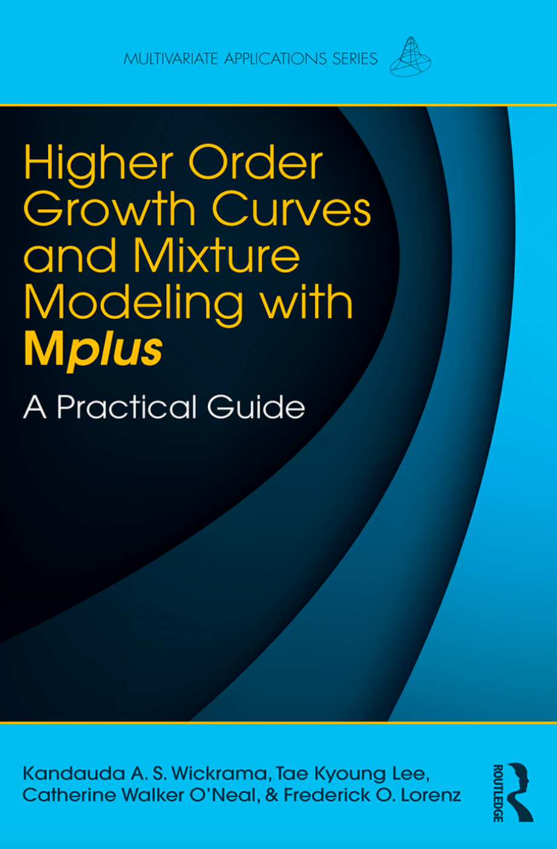
Wickrama, K., Kyoung Lee, T., Walker O’Neal, C., & Lorenz, F. (2016). Higher Order Growth Curves and Mixture Modeling with Mplus. New York: Routledge.

Slide 6

Saunders, M., Lewis, P., & Thornhill, A. (2009). Research methods for business students. Fifth edition. Essex: Pearson Education Limited.

Slide 7
Additionally, there is a free resource of research methods by William M.K. Trochim (Cornell University): Research Methods Knowledge Base
https://conjointly.com/kb/

Slide 8
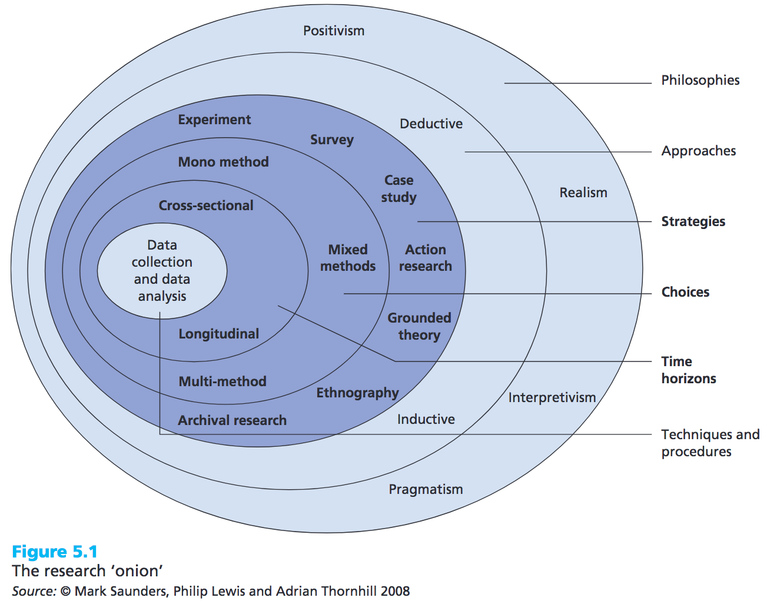
(Saunders, Lewis, & Thornhill, 2009, p. 138)

Slide 9
Content
Introduction
Design
Types of design
Mono/multi/mixed-method research
Time and design
Data collection
Survey design
Statistical data analysis

Slide 10
Any study ”... should make an interesting claim; it should tell a story that an informed audience will care about and it should do so by intelligent interpretation of appropriate evidence from empirical measurements or observations.” (Abelson, 1995, p. 2)
Essential questions:
Rigor
Credibility
Relevance

Slide 11
(Saunders, Lewis, & Thornhill, 2009, p. 138)

Slide 12
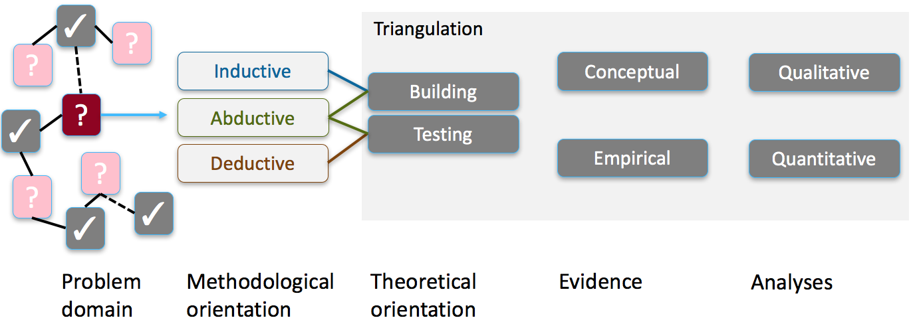
Introduction
Logic of the research
Inductive (test>pattern>theory)
Bottom-up, generalizing from specific cases, ’building’ theories
Deductive (theory>hypothesis>test>confirmation/rejection)
Top-down, application of general rules, ’testing’ theories
Abductive
Hypothesis is just a guess -> decision making rules, theory verification/falsification and/or theory building

Slide 13
Introduction
What is theory?
Theory is about the connections between phenomena, a story about why events, structure and thoughts occur.
Theory emphasises the nature of causal relationships, identifying what comes first as well as the timing of events.
Strong theory delves into underlying processes so as to understand the systematic reasons for a particular occurrence or non-occurrence.
(Sutton & Staw, 1995)

Slide 14
Introduction
What theory is not?
References. Listing references to existing theories is needed, but in addition logical arguments to explain the reasons for the described phenomena must be included.
Data. Any data merely describe which empirical patterns were observed: theory explains why these patterns were observed or are expected to be observed.
Lists of variables. Simply listing variables which may predict an outcome is insufficient: what is required for the presence of theory is an explanation of why predictors are likely to be strong predictors.
Diagrams. Boxes and arrows can add order to a conception by illustrating patterns and causal relationships but they rarely explain why the relationships have occurred.
Hypotheses or predictions. Hypotheses can be part of a sound conceptual argument, but they do not contain logical arguments about why empirical relationships are expected to occur.
(Sutton & Staw, 1995)

Slide 15
Introduction
Most important questions of any research:
Scientific impact
Existing research, review (e.g., Paré et al., 2015) > research gap
Solid theoretical framework
Design that allows investigation of the issue(s)
Robust method(s)
Dissemination to academia (academic journals, books, chapters, proceedings, workshops/seminars)
Societal impact
Societal problem/issue that needs attention
Dissemination to public (non-academic books, journals, workshops/seminars)

Slide 16
Content
Introduction
Design
Types of design
Mono/multi/mixed-method research
Time and design
Data collection
Survey design
Statistical data analysis

Slide 17
Original idea for the research
Literature review
Research questions / hypotheses
Design
Database of scientific knowledge
Methodology
Intro/theory
RQ’s
Design
vs.
Methodology?
Method
Publication of the report
Results
Primary / secondary data
Conclusions
Discussion
Instruments
Peer review
Writing a scientific report
Data analyses
Data collection

Slide 18
Design
Design focuses on the procedures related to outcomes
Historical, comparative, interpretive, exploratory research
What evidence is needed to answer research question(s)?
Methodology focuses on the research process (instrumentation and analyses)
Primary data (collected first time by a research group) and/or secondary data (already collected by others)
How to conduct analyses in robust and unbiased way?

Slide 19
Content
Introduction
Design
Types of design
Mono/multi/mixed-method research
Time and design
Data collection
Survey design
Statistical data analysis

Slide 20
(Saunders, Lewis, & Thornhill, 2009, p. 138)

Slide 21
Experimental design
‘Pretest post-test randomized experiment’
Applied in many fields, needs a random sample (‘probability sample’) and random assignment (participants are randomly selected for the experimental and control groups).
Research is conducted in a controlled environment (e.g., laboratory) with experiment and control groups (threat to external validity due to artificial environment).
Using experimental design, both reliability and validity are maximized via random sampling and control in the given experiment (de Vaus, 2004).

Slide 22
Experimental design
Random assignment
Exp.
Pre
I
Post
Random sample
Contr.
Pre
-
Post

Slide 23
Quasi-experimental design
‘Non-equivalent groups design’
Resembles experimental design but lacks random assignment (sometimes also random sampling) and controlled research environment.
This type of design is sometimes the only way to do research in certain populations as it minimizes the threats to external validity (natural environments instead of artificial ones).
Exp.
Pre
I
Post
Random / convenience sample
Contr.
Pre
-
Post

Slide 24
Correlational design
‘Descriptive study’ or ‘observational study’
Allows the use of non-probability sample (a.k.a ‘convenience sample’).
Most correlational designs are missing control, and thus loose some of their scientific power (Jackson, 2006).
Some research journals accept factorial analysis (main and interaction effects, e.g., MANOVA) based on correlational design.
Convenience sample
Exp.
Pre
I
Post

Slide 25
RANDOM
SAMPLING
RANDOM
SELECTION
pretest-posttest randomized DESIGN
TEST
Pre
I
Post
RS
CONTROL
Pre
-
Post
Non-Equivalent Groups DESIGN
TEST
Pre
I
Post
RS
CONTROL
Pre
-
Post
Correlational DESIGN
CS
Pre
Post
TEST
I

Slide 26
Survey
The survey strategy is usually associated with the deductive approach.
It is most frequently used to answer who, what, where, how much and how many questions (exploratory and descriptive research).
Surveys are often obtained by using a questionnaire administered to a sample, standardisation of the data allows easy comparison.
It is possible to generate findings from a survey data that are representative of the whole population at a lower cost (than collecting the data for the whole population).

Slide 27
Case study
Applies both qualitative and quantitative methods
The aim is to collect information from one or more cases and study, describe and explain them through why, what and how questions.
Explanatory and exploratory research.
Single case (or multiple cases) are represented, for example, by organization, individual, communication and experiences (for thorough discussion, see Flyvbjerg, 2004).
Focus group analysis (MacNaghten & Myers, 2004) is heavily based on non-independent observations as informants may (or are asked) talk to each other during the data collection.

Slide 28
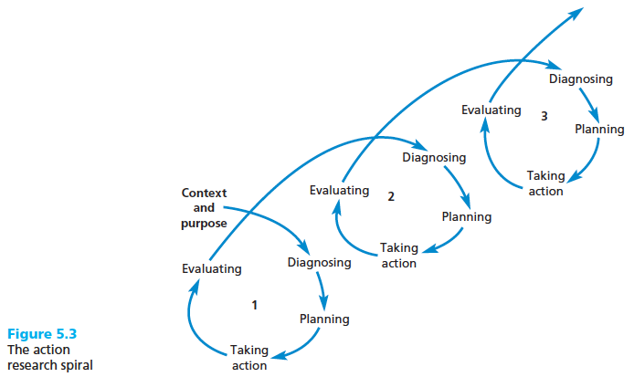
Action research
Focuses in action rather than on research about action.
Aims to promote change (e.g., resolution of organizational issues) – useful to solve how questions.
Involves collaboration of researchers and practitioners in the research (democratic partnership).
Is based on an iterative cyclic process of diagnosing, planning, taking action and evaluating.
Aims to have implications beyond the research project.
(Saunders, Lewis, & Thornhill, 2009, p. 147-148)

Slide 29
Content
Introduction
Design
Types of design
Mono/mixed/multi-method research
Time and design
Data collection
Survey design
Statistical data analysis

Slide 30
(Saunders, Lewis, & Thornhill, 2009, p. 138)

Slide 31
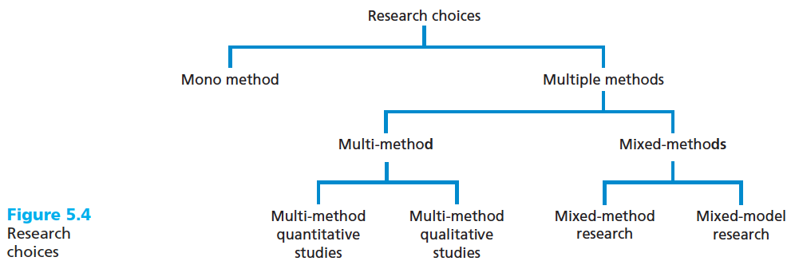
Mono/multi/ mixed-method research
(Saunders, Lewis, & Thornhill, 2009, p. 152)

Slide 32
Mono/multi/ mixed-method research
Mono-method research
Use of single qualitative or quantitative data collection technique (e.g., in-depth interviews or surveys) with data analysis procedures.
Multi-method research
More than one data collection technique is used with associated analysis techniques.
Restricted to either qualitative or quantitative approach (e.g., multi-method quantitative study that uses both questionnaires and structured observation).
(Bergman, 2008; Creswell & Plano Clark, 2011; Saunders, Lewis, & Thornhill, 2009)

Slide 33
Mono/multi/ mixed-method research
Mixed-method research
Quantitatively and qualitatively driven design.
Interactive or equal status design.
Team of qual, quan and mixed-method researchers.
(Bergman, 2008; Creswell & Plano Clark, 2011; Saunders, Lewis, & Thornhill, 2009)

Slide 34
Content
Introduction
Design
Types of design
Mono/multi/mixed-method research
Time and design
Data collection
Survey design
Statistical data analysis

Slide 35
(Saunders, Lewis, & Thornhill, 2009, p. 138)

Slide 36
Time and design
Longitudinal design (or panel study) includes series of measurements over time, producing longitudinal (or panel) data.
Participants remain the same throughout the study.
Change over time, age effect.
May allow investigation of causality if
X (or IV, input/predictor/covariate variable) and Y (or DV, outcome/response/output variable) correlate,
X precedes Y chronologically,
X and Y are still related after controlling other dependencies.
Suffers from participant drop-out (one way to deal with this is imputation of missing data).
One-dimensional special cases of longitudinal/panel data:
Time-series data
Cross-sectional data

Slide 37
Time and design
Time series data is entered in time order.
Natural temporal order.
Cross-sectional design involves usually one measurement (e.g., survey).
Data is not entered in specific order (no natural temporal order).
Causal conclusions are out of scope of this research type.
Faster and cheaper to conduct than longitudinal design, but produces less controllable and powerful results.

Slide 38
Content
Introduction
Design
Types of design
Mono/multi/mixed-method research
Time and design
Data collection
Probability sampling
Non-Probability sampling
Survey design
Statistical data analysis

Slide 39
(Saunders, Lewis, & Thornhill, 2009, p. 138)

Slide 40
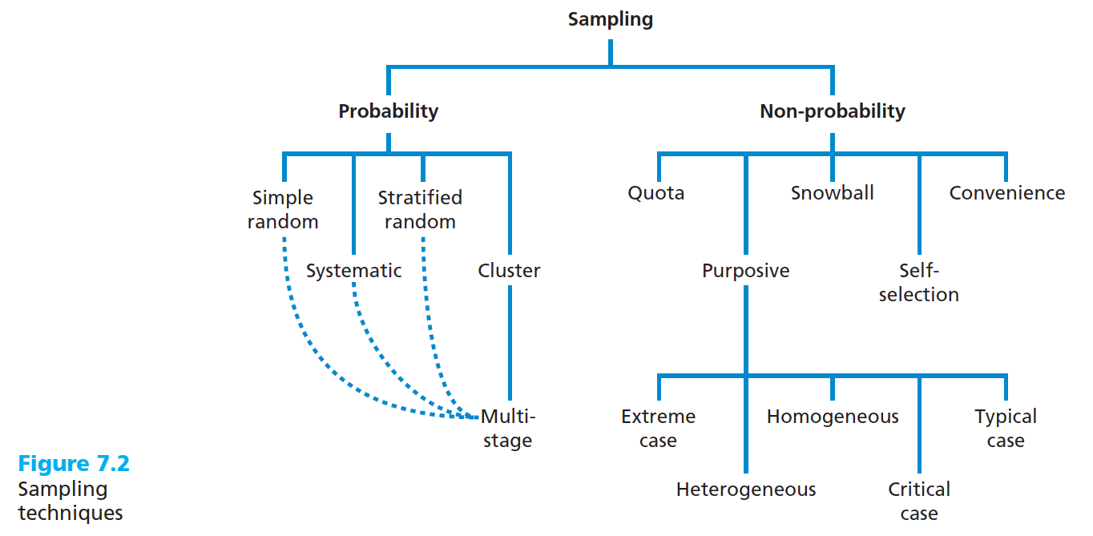
Sampling techniques
(Saunders, Lewis, & Thornhill, 2009, p. 213)

Slide 41
Probability sampling
Identify a suitable sampling frame based on your research question(s) or objectives.
Depends on the research question
How is organization X employees work-related well-being? List of organization members’ email/postal addresses.
What is the Finnish technical university students’ level of study-related well-being? Student register list with contact details.
Decide on a suitable sample size.
Select the most appropriate sampling technique and select the sample.
Check that the sample is representative of the population.
(Saunders, Lewis, & Thornhill, 2009, p. 214)

Slide 42
Sampling frame
Depends on the research question
What is the organization X employees level of work-related well-being? List of organization members’ email/postal addresses.
What is the Finnish technical university students’ level of study-related well-being? Student register list with contact details.
(Saunders, Lewis, & Thornhill, 2009, p. 214-217)

Slide 43
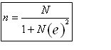
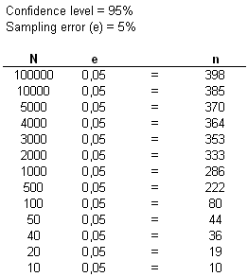
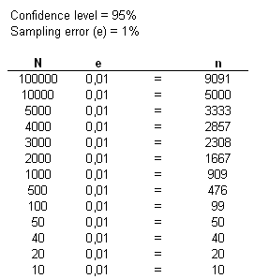
Estimation of the minimum sample size
N
Population size.
n
Estimated sample size.
Sampling error, Margin of error (e)
Difference between the true (unknown) value and observed values, if the survey were repeated (=sample collected) numerous times.
Confidence interval
Spread of the observed values that would be seen if the survey were repeated numerous times.
Confidence level
How often the observed values would be within sampling error of the true value if the survey were repeated numerous times.
(Murphy & Myors, 1998)

Slide 44
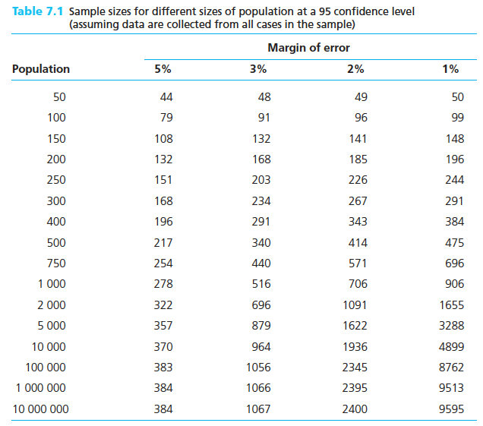
Estimation of the minimum sample size
(Saunders, Lewis, & Thornhill, 2009, p. 219)

Slide 45

Estimation of the actual sample size
Estimate the minimum sample size for the statistical analyses
For example, 5% margin of error with a population size of a) 500 individuals = 217 or b) 4000 individuals = 364).
Statistical analyses may require a larger sample:
There are two or more groups to compare (minimum sample size multiplied by the number of groups)
Large number of variables to analyze at the same time (multivariate analyses may need for technical reasons 30 individuals per each variable: if you have a model with 10 variables, you may need a minimum sample size of 300)
Estimate the expected response rate based on existing research, your own expectations, etc.
Quite often survey studies have a response rate around 30-40%, but this totally depends on your design: an email call to participate in a survey might lead to a low response rate of 20%!
Calculate the actual sample size:
Expected response rate 30%:
(217*100)/30=723 (!)
(364*100)/30=1213
(Saunders, Lewis, & Thornhill, 2009, p. 219-221)

Slide 46
Sampling techniques
(Saunders, Lewis, & Thornhill, 2009, p. 213)

Slide 47
Probability sampling techniques
Random sampling
Number the cases in the sampling frame (e.g., a list of possible participants in Excel)
Select cases using random numbers (e.g., in Excel using “=RANDBETWEEN(1;434)” with an actual sample size of 434).
Systematic sampling
Number the cases in the sampling frame (that should be in a random order, e.g., not having all males listed before females)
Select the first case using a random number
Calculate the sampling fraction (actual sample size/total population), for example: 434/500 = 0.9; 728/4000 = 0.18
Select subsequent cases (first example: should use random sampling; second example: select every 5th)
(Saunders, Lewis, & Thornhill, 2009, p. 222-228)

Slide 48
Probability sampling techniques
Stratified random sampling
The sampling frame is divided into a number of subsets (strata), for example, TAU Faculties or public and private-sector companies and then random or systematic sampling is applied to each subset.
Choose the stratification variable or variables (e.g., TAU faculties)
Divide the sampling frame into the discrete strata (e.g., job titles within each faculty)
Number each of the cases within each job title within each faculty with a unique number (1, 2, …)
Select your sample using either simple random or systematic sampling
(Saunders, Lewis, & Thornhill, 2009, p. 228-230)

Slide 49
Sampling techniques
Cluster sampling
The sampling frame consists of clusters (e.g., geographical areas like municipalities) that contain interesting research units (e.g., metal industry companies).
(Saunders, Lewis, & Thornhill, 2009, p. 230-231)

Slide 50
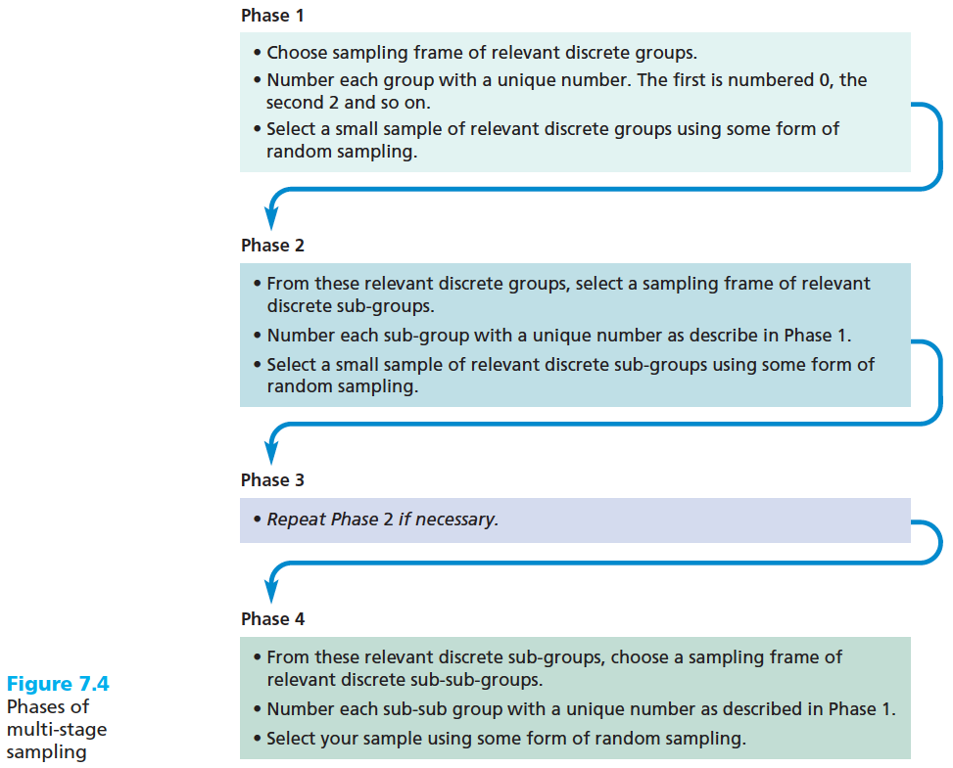
Sampling techniques
Multi-stage sampling
(Saunders, Lewis, & Thornhill, 2009, p. 230-231)

Slide 51
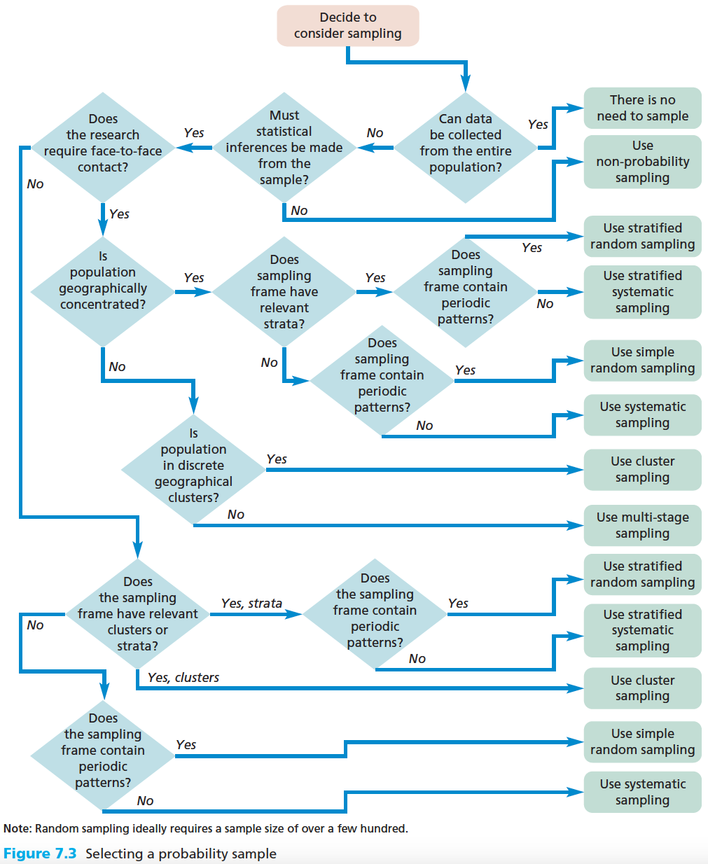
(Saunders, Lewis, & Thornhill, 2009, p. 223)

Slide 52
Representative sample for the population
You may compare your sample characteristics to population known characteristics (e.g., age, gender or job title distribution, number of public and private companies, average salary level, etc.).
(Saunders, Lewis, & Thornhill, 2009, p. 232-233)

Slide 53
Sampling techniques
(Saunders, Lewis, & Thornhill, 2009, p. 213)

Slide 54
Non-probability sampling
Decide on a suitable sample size.
Select the most appropriate sampling technique and select the sample.
(Saunders, Lewis, & Thornhill, 2009, p. 233-235)

Slide 55
Non-probability sampling techniques
Quota sampling
Purposive (judgemental) sampling
Snowball sampling
Self-selection sampling
Convenience (haphazard) sampling
(Saunders, Lewis, & Thornhill, 2009, p. 235-242)

Slide 56
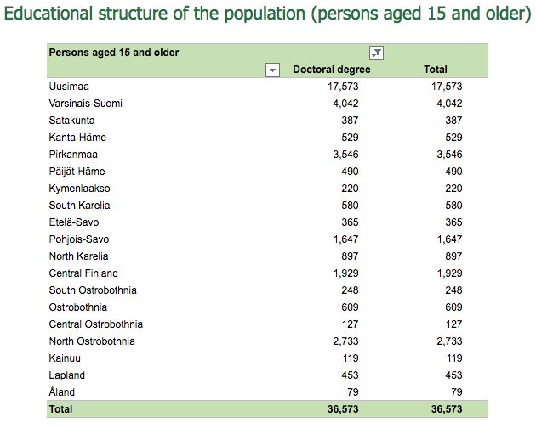
Non-probability sampling techniques
Quota sampling
Non-random method, usually applied in quantitative interview surveys.
Quotas are based on relative proportions of the population.
For example, from a population of 36573 doctors we are going to have a 2 % quota sample of 731.
Uusimaa, Finland: 17573 doctors * 0,02 (quota) = 352 survey participants, Varsinais-Suomi, Finland: 4042 doctors * 0,02 = 81 survey participants, etc.
(Vipunen statistical service, https://vipunen.fi; Saunders, Lewis, & Thornhill, 2009, p. 235-242)

Slide 57
Non-probability sampling techniques
Purposive (judgemental) sampling
Used in qualitative studies (small samples) to select cases that will best enable to answer the research questions.
Extreme case (deviant) sampling focuses on unusual or special cases
Findings from extreme cases may be relevant in understanding or explaining more typical cases
Heterogeneous (maximum variation) sampling focuses on key themes by identifying diverse characteristics
A small sample containing completely different cases
Critical case sampling selects critical cases that that are important
If it happens there, will it happen everywhere?
Typical case sampling provides an illustrative profile using representative cases
(Saunders, Lewis, & Thornhill, 2009, p. 235-242)

Slide 58
Non-probability sampling techniques
Snowball sampling
Used in qualitative studies when it is difficult to identify participants for the study
Make contact with one or two cases in the population
Ask these cases to identify further cases
Ask these new cases to identify further new cases (and so on)
Stop when either no new cases are given or the sample is as large as is manageable
(Saunders, Lewis, & Thornhill, 2009, p. 235-242)

Slide 59
Non-probability sampling techniques
Self-selection sampling
Individuals are allowed to volunteer to take part in the study.
Publicise (internet, magazines, etc.) your need for cases, either by advertising through appropriate media or by asking them to take part
Collect data from those who respond
(Saunders, Lewis, & Thornhill, 2009, p. 235-242)

Slide 60
Non-probability sampling techniques
Convenience (haphazard) sampling
Participants or cases are selected on the basis of accessibility (peer students in a class of statistical methods, business leaders how take part in a professional development course, geographically close schools or companies, etc.)
Prone to produce a biased sample if the population is heterogeneous.
(Saunders, Lewis, & Thornhill, 2009, p. 235-242)

Slide 61
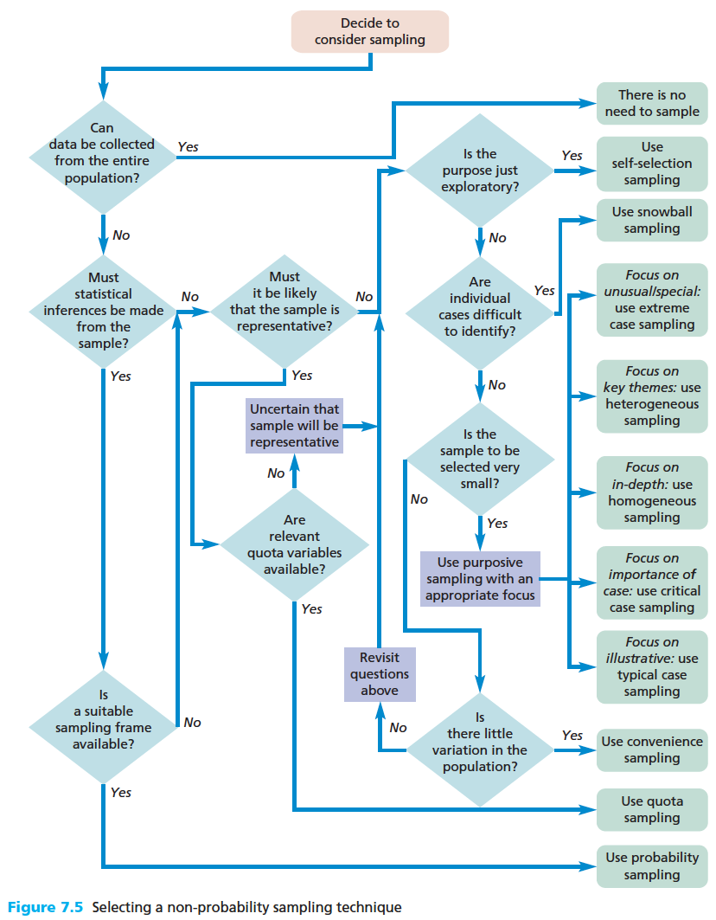
(Saunders, Lewis, & Thornhill, 2009, p. 235-242)

Slide 62
Content
Introduction
Design
Types of design
Mono/multi/mixed-method research
Time and design
Data collection
Survey design
Statistical data analysis

Slide 63
Survey design
Should I create my own scale or use an existing one?
Usually a survey contains several scales, e.g., to compare “workplace learning opportunities” (scale 1) and “work-related stress (scale 2).
First question to consider: Do we need another scale on a topic of “xxx”?
International journals/books contain several existing (and validated) scales for many purposes.
If you decide to make a scale of your own, you need to justify its need carefully (reviewers will most probably ask for this).
Second question: Am I ready to go through a tedious scale development process?
Creating a “real” scale is a hard process, takes some time (often year/years) and usually requires group work.

Slide 64
Survey design
But what if I just make quickly a scale for my masters/PhD study? I browsed the Internet databases and some journals but could not find one that would measure what I need ...
There is a big difference if your goal is to publish a master’s thesis (monograph) or a Doctoral thesis (that usually consists of articles in peer-reviewed journals).
Master’s thesis: If the goal is to learn how to make scales, then why not?
Doctoral thesis: Use of previously published and properly validated scales makes the whole process usually safer (and publishing the results smoother):
The scale should work properly also with your own data (as it is tested and the results are reported elsewhere)
You will save some “words” in your manuscripts as you do not have to describe the scale development process (it is enough to cite the original publication/s)
You can cite the findings of earlier studies that have used the same scale (plus have indicator values for comparison, e.g., Cronbach alpha)
Reviewers of your manuscript may know (or have even used) the scale

Slide 65
Survey design
I browsed the Internet databases and some journals but could not find one that would measure what I need ...
Quite many existing scales could be slighly modified to fit your measurement need(s).
For instance, you may state that “I need to develop a new scale as my interest lies on Finnish employees’ autonomy satisfaction in work-related situations. Existing international scales have been validated in some other countries”.
Is the cultural (i.e., Finnish) context (or some other, e.g., “studies” vs. “internship” vs. “work”) that much different? Can you slightly modify item wordings to make them fit your study?
There are sometimes big differences, for instance:
Western vs other cultures
Child vs adolescent vs adult
Studying vs working
Trait level (e.g., general experienced “work competence”) vs state level (experienced “work competence” in different daily work tasks

Slide 66
Survey design
I want to make a scale of my own!!!
Ok, then. Think about the concept you are about to measure: is it on a unidimensional or multidimensional scale?
Unidimensional: Person’s weight (0 – xx kg), height (0 – xx cm) or preference for vanilla icecream (0 = not at all, ..., 5 = very much)
Multidimensional: Person’s satisfaction of basic psychological needs (“autonomy”, “competence” and “relatedness” dimensions) or general intelligence (e.g., “verbal” and “mathematical” dimensions)
These could be thought as a combination of several unidimensional scales.
More details on unidimensional scaling methods are available from the Research Methods Knowledge Base:
Thurstone scaling
Likert scaling
Guttman scaling

Slide 67
Survey design
If we are to develop an unidimensional scale, the next step is to write out the concept that we are interested in.
For example, if our goal is to create survey items measuring “autonomy” (that is one of the three basic psychological needs in Self-Determination Theory) we could define the central concept as
“the feeling one has choice and willingly endorsing one's behavior” or
(in the context of occupational psychology) “a relatively high level of discretion granted to an employee in his or her work”.
Then we proceed to create a (long) list of statements that (according to our belief) measure the concept.
Previous slide introduced three approaches for selecting the “final list of items” (Thurstone, Likert, Guttman), e.g., with the help of expert (“judges”) opinions.

Slide 68
Survey design
A detailed example of scale development process is provided in MMX9120 homepage (https://homepages.tuni.fi/petri.nokelainen/mmx9120/) > ”Issues in Study Design” > ”Readings” > Tirri, K., Nokelainen, P., & Komulainen, E. (2013). Multiple intelligences: Can they be measured? Psychological Test and Assessment Modeling, 55(4), 438-461.

Slide 69
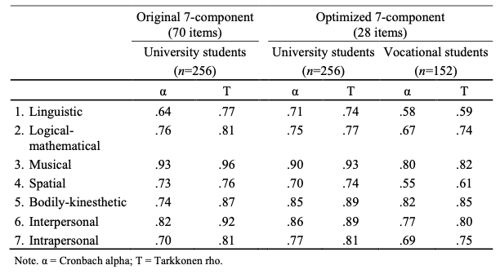
Survey design
A goal was to develop a self-assessment (Likert-type) scale for the seven different Multiple Intelligences (according to Howard Gardner’s MI theory, 1983).
Research group created a pool of 70 items (10 items per dimension) that were presented to 408 respondents.
Item properties were analysed and the final n of items in the scale became 28 (four items per dimension).

Slide 70
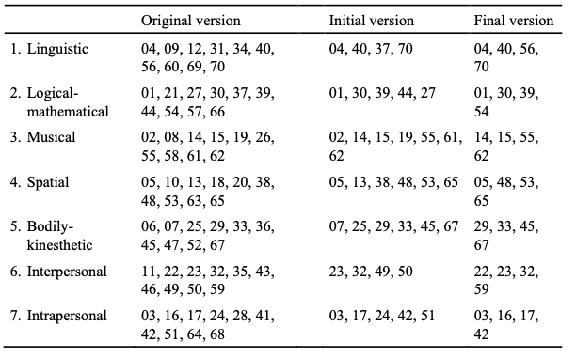
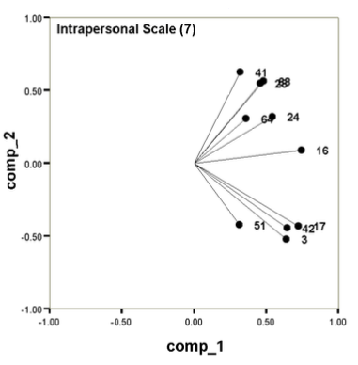
Survey design
Many challenges were encountered during the process (that started in 2001).
For example, the ”intrapersonal” factor was found to be two-dimensional:

Slide 71
Survey design
The omitted (red) items differ from the selected (green) items as they are not that much focused on the intrinsic processes (self-thoughts, reflection, ...).
*3. I often think about my own feelings and sentiments and seek reasons for them.
*16. I am able to analyse my own motives and ways of action.
*17. I spend time regularly reflecting on the important issues in life.
24. I have opinions of my own and dare to disagree with others.
28. I have a realistic idea of my strengths and weaknesses.
41. I am able to handle criticism directed against me.
*42. I like to read psychological or philosophical literature to increase my self-knowledge.
51. I keep a diary or note down happenings of my inner life.
64. When necessary, I am able to motivate myself, even for unpleasant tasks.
68. I can handle the emotions caused by serious setbacks.

Slide 72
Survey design
The previous example was about building trait level scales for the seven MI factors.
Another example of a trait level scale is the satisfaction of autonomy (in the context of Self-Determination theory).
The scale was developed by Chen et al. (2015) and it contains four items (response options 1 = Not true at all, ..., 5 = Completely true):
1. I feel a sense of choice and freedom in the things I undertake
2. I feel that my decisions reflect what I really want
3. I feel my choices express who I really am
4. I feel I have been doing what really interests me
This scale was designed to measure a general level of autonomy satisfaction.
Chen B., et al. (2015). Basic psychological need satisfaction, need frustration, and need strength across four cultures. Motivation and Emotion, 39, 216–236

Slide 73
Survey design
One could also wish to measure autonomy on a state level (e.g., attached to daily tasks over one-week period of time).
Based on the previous trait level scale, Van der Kaap-Deeder et al. (2017) developed a two-item trait level version of the scale:
1. Today I felt a sense of choice and freedom in the things I undertook
2. Today I felt that my decisions reflected what I really wanted
This scale is designed to be used repeatedly over period of time to measure (daily) fluctuations in autonomy satisfaction.
Van der Kaap-Deeder, J., Vansteenkiste, M., Soenens, B., & Mabbe, E. (2017). Children’s daily well-being: The role of mothers’, teachers’, and siblings’ autonomy support and psychological control. Developmental Psychology, 53(2), 237–251.

Slide 74
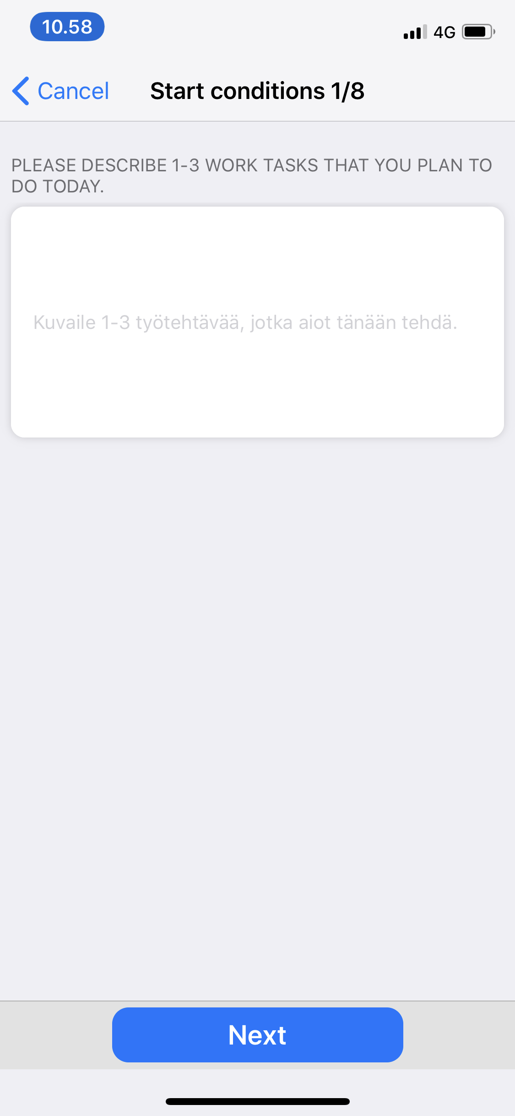

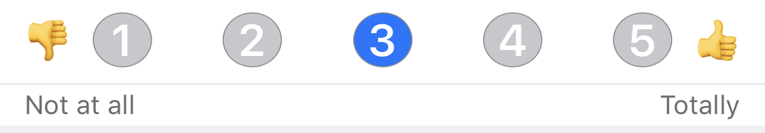
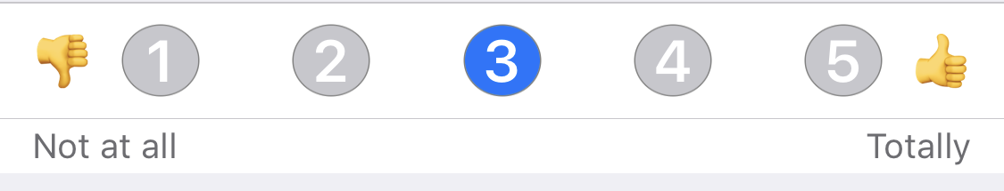
Survey design
Before work day: Task 2
We have applied the state (diary) version of the autonomy satisfaction (Van der Kaap-Deeder et al., 2017) in our experience sampling studies (data collected several times per day via smartphone application).
Using only one question per session:
TASK 2 (OPTIONAL)
I FEEL FREEDOM OF CHOICE AND CONTROL OVER THIS WORK TASK
THIS IS A WORK TASK THAT WILL DEVELOP MY COMPETENCE

Slide 75
Content
Introduction
Design
Types of design
Mono/multi/mixed-method research
Time and design
Data collection
Survey design
Statistical data analysis

Slide 76
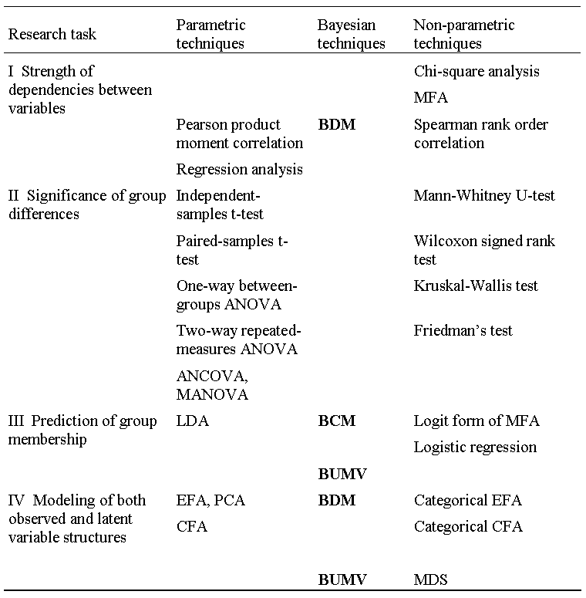
Statistical analyses
S
P
S
S
S
P
S
S
SPSS Extension
AMOS
MPlus
(Tabachnik & Fidell, 1996; Nokelainen, 2008.)

Slide 77
Statistical analyses
In the social science researchers point of view, the requirements of traditional frequentistic statistical analysis are very challenging.
For example, the assumption of normality of both the phenomena under investigation and the data is prerequisite for traditional parametric frequentistic calculations.
Continuous
age, income, temperature, ..
0
∞
Discrete
FSIQ in the WAIS-III, Likert –scale,
favourite colors, gender, ..
0
1
2, ..

Slide 78
Statistical analyses
In situations where
a latent construct cannot be appropriately represented as a continuous variable,
ordinal or discrete indicators do not reflect underlying continuous variables,
the latent variables cannot be assumed to be normally distributed,
traditional Gaussian modeling is not appropriate.
In addition, normal distribution analysis sets minimum requirements for the number of observations, and the measurement level of variables should be continuous.

Slide 79
Statistical analyses
Parametric statistics
Pearson Product Moment Correlation r_{P}
Independent-samples t
Paired-samples t
One-way between-groups ANOVA F
Two-way repeated-measures ANOVA F
ANCOVA, MANOVA
Regression analysis R
Exploratory factor analysis
Principal component analysis
Cluster analysis
Discriminant analysis
Classification analysis
Confirmatory factor analysis
Non-parametric stastistics
Chi-square χ²
Multiway Frequency Analysis χ²
Spearman Rank Order Correlation r_{S}
Mann-Whitney U
Wilcoxon Signed Rank
Kruskal-Wallis H
Friedman
Bayesian dependency modeling (B-Course)
Logit analysis, Logistic regression
Bayesian classification modeling (B-Course)
Categorical variable modeling (Mplus)
(Nokelainen, Silander, Ruohotie & Tirri, 2007; Nokelainen & Ruohotie, 2009 ; Tabachnik & Fidell, 1996)

Slide 80
General Linear Model (GLM)
¹ Multivariate = several dependent variables
X (IV) Y (DV)
(3.2)
Pearson product moment correlation (r) 1, continuous 1, continuous
(3.3)
Regression analysis n, continuous 1, continuous
Analysis of variance (n-way ANOVA) n, discrete 1, continuous
Two-group linear discriminant analysis (LDA) n, continuous 1, dichotomous
(3.4)
Multivariate regression analysis¹ n, continuous n, continuous
Multivariate analysis of variance (MANOVA)¹ n, discrete n, continuous
Linear discriminant analysis (LDA)¹ n, continuous n, discrete
Exploratory factor analysis (EFA)¹ n, latent n, continuous
Principal component analysis (PCA)¹ n, latent n, continuous

Slide 81
Single group (no control)
- Normally distributed test scores: paired t-test
- Non-normal test scores: Wilcoxon paired test
Pre test
Post test
Course on topic X
Week 1 2 3 4 5

Slide 82
Single group (no control)
- Normally distributed test scores: repeated measures ANOVA
- Non-normal test scores: Friedman test
Test 1
Test 2
Test 3
Course on topic X
Week 1 2 3 4 5
Intervention 1
Intervention 2

Slide 83
Two-group (intervention and control)
Normally distributed test scores:
Repeated measures ANOVA (different mean change from pre to post between two groups)
ANCOVA (pre test is a covariate: different post test means between two groups)
Linear mixed-effects modeling (allows unbalanced sample = missing values)
- Non-normal test scores: Wilcoxon paired signed-rank test
Pre test
Post test
Course on topic X: Intervention
Course on topic X: Control
Week 1 2 3 4 5

Slide 84
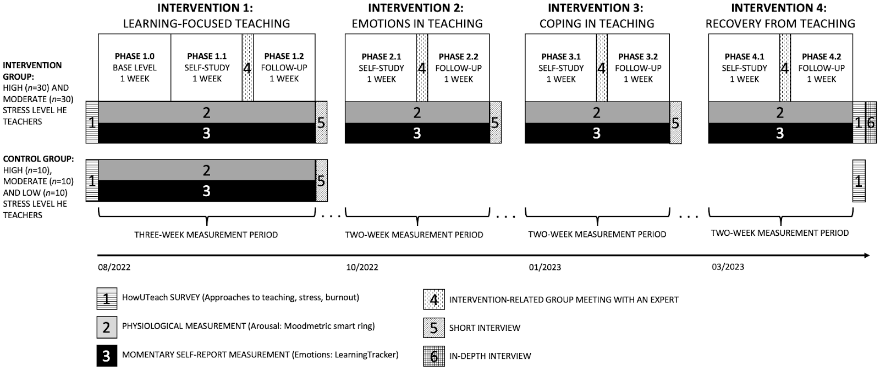

Slide 85
Two-group (intervention and control)
- Normally distributed test scores: Linear mixed-effects modeling
- Non-normal test scores: Mann-Whitney test
Test 1
Test 2
Test 3
Course on topic X: Intervention
Course on topic X: Control
Week 1 2 3 4 5

Slide 86
Two-group (intervention and control)
- Normally distributed test scores: Linear mixed-effects modeling
Test 1
MAP 1
Test 2
MAP 2
Test 3
MAP 3
Course on topic X: Intervention
Course on topic X: Control
Week 1 2 3 4 5

Slide 87
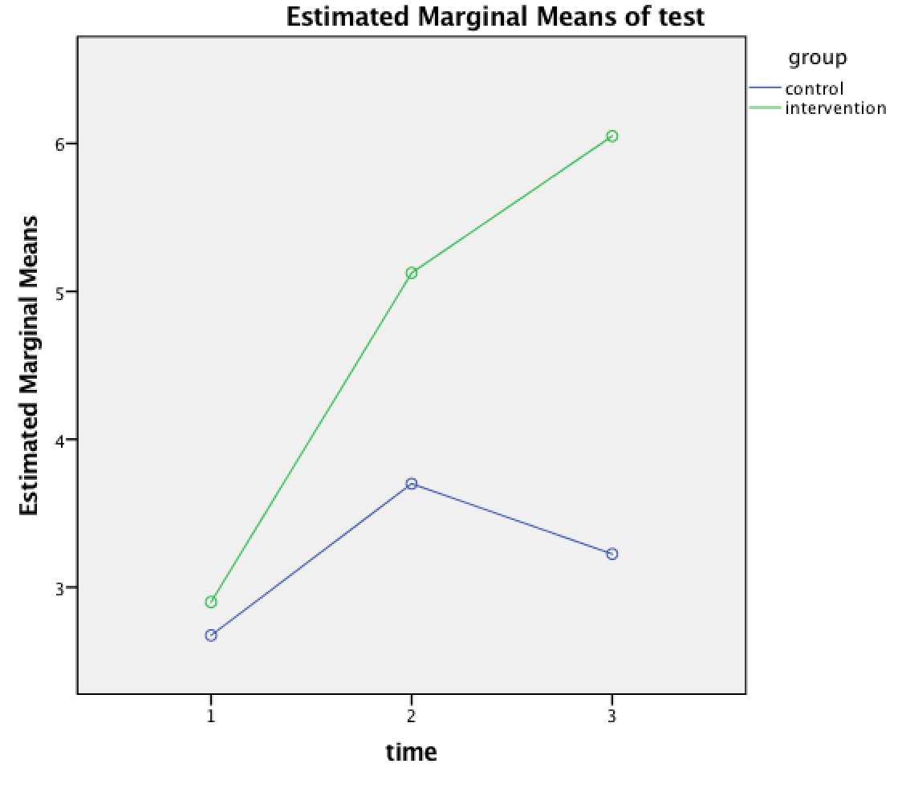
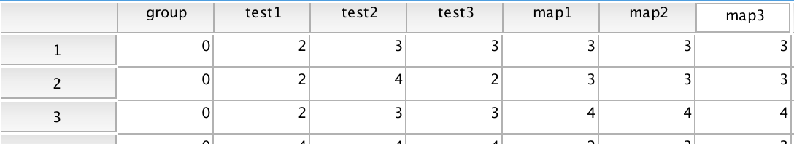
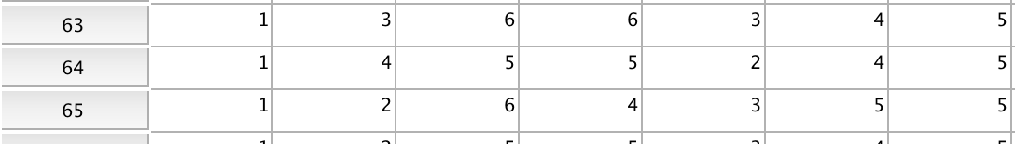
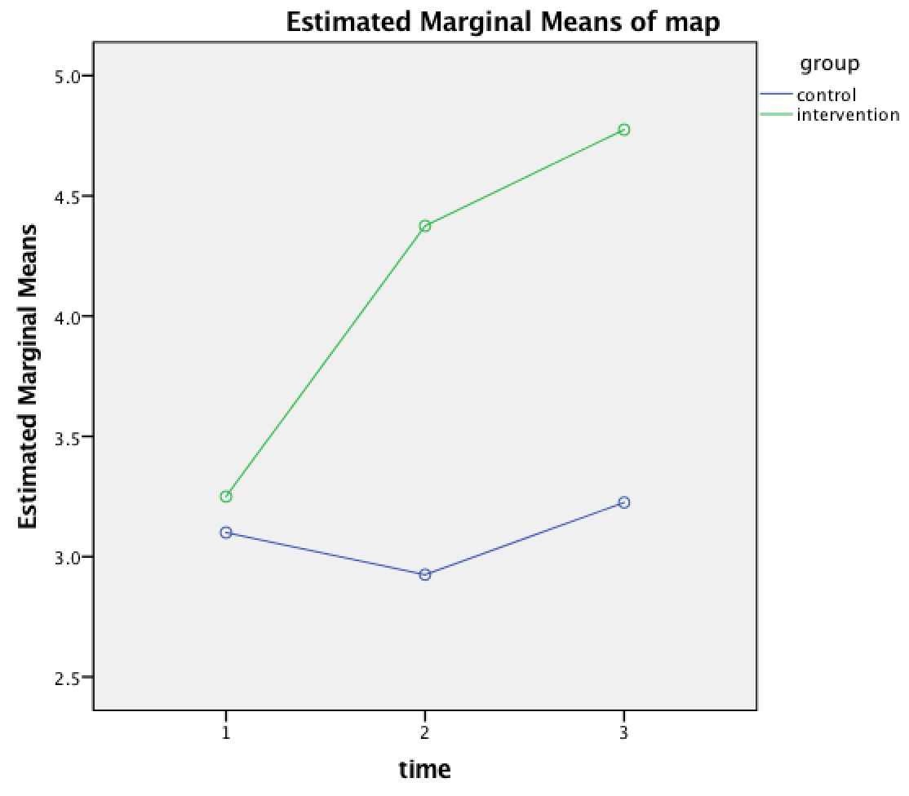
…
GLM test1 test2 test3 map1 map2 map3 BY group
/WSFACTOR=time 3 Polynomial
/MEASURE=test map
/METHOD=SSTYPE(3)
/POSTHOC=group(TUKEY GH)
/PLOT=PROFILE(time*group)
/EMMEANS=TABLES(time) COMPARE ADJ(BONFERRONI)
/EMMEANS=TABLES(group*time)
/PRINT=DESCRIPTIVE ETASQ HOMOGENEITY
/CRITERIA=ALPHA(.05)
/WSDESIGN=time
/DESIGN=group.

Slide 88
M = Motivational level
self-assessment, survey
E = Emotion
self-assessment, survey
ambulatory assessment, EDA
S = Regulation strategies
self-assessment, diary/survey
RM = Regulation of motivation
Confirmatory Factor Analysis (CFA)
e_{M}
e_{E}
e_{S}
M
E
S
RM
Survey
Course on topic X
Week 1 2 3 4 5
(Bollen, 1989; Hair et al., 1995; Kaplan, 2000; Tabachnick & Fidell, 1996; Wickrama et al., 2016.)

Slide 89
An example of a structural equation model
4-9 grade students from Finland and China (N=1862)
ITI (α=.863)
(1) You have a certain amount of intelligence, and you really can’t do much to change it.
(2) Your intelligence is something that you can’t change very much.
(3) To be honest, you can’t really change how intelligent you are.
(4) You can learn new things, but you can’t really change your basic intelligence.
Neutral (α=.783)
(1) It went well.
(2) Fine result!
(3) Great!
(4) Wow! That’s a really good score!
Person (α=.682)
(5) You are so smart in this subject!
(6) You are so gifted!
(7) You always do great in exams!
Process (α=.791)
(8) I can see that you have put a lot of effort in learning new issues.
(9) You practiced a lot and it can be seen in this result!
(10) You must have worked hard for this score!
(11) It was worthwhile to read for the exam!
PRAISE NEUTRAL
ITI
PRAISE PERSONAL
ITG
PRAISE PROCESS
ITG (α=.854)
(1) You have a certain amount of giftedness, and you really can’t do much to change it.
(2) Your giftedness is something that you can’t change very much.
(3) To be honest, you can’t really change how gifted you are.
(4) You can learn new things, but you can’t really change your basic giftedness.

Slide 90
Mplus code
TITLE: Finland China
DATA:
FILE IS finchi_stud_n1862.csv;
VARIABLE:
NAMES ARE COUNTRY CLASS CLASSC GENDER GRADEL GRADEM
ITI1-ITI4 ITG1-ITG4 PRAISE1-PRAISE16;
USEVARIABLES ARE COUNTRY CLASS GENDER GRADEL GRADEM
ITI1-ITI4 ITG1-ITG4 PRAISE1-PRAISE9 PRAISE11 PRAISE13 PRAISE15;
CATEGORICAL ARE
ITI1-ITI4 ITG1-ITG4 PRAISE1-PRAISE16;
MISSING ARE .;
MODEL:
ITI BY ITI1-ITI4;
ITG BY ITG1-ITG4;
PRA1NEU BY PRAISE1 PRAISE5 PRAISE9 PRAISE13;
PRA2PER BY PRAISE2 PRAISE4 PRAISE6 PRAISE8;
PRA3PRO BY PRAISE3 PRAISE7 PRAISE11 PRAISE15;
PRA1NEU ON ITI ITG COUNTRY CLASS GENDER GRADEL GRADEM;
PRA2PER ON ITI ITG COUNTRY CLASS GENDER GRADEL GRADEM;
PRA3PRO ON ITI ITG COUNTRY CLASS GENDER GRADEL GRADEM;
ITI ON COUNTRY CLASS GENDER GRADEL GRADEM;
ITG ON COUNTRY CLASS GENDER GRADEL GRADEM;

Slide 91
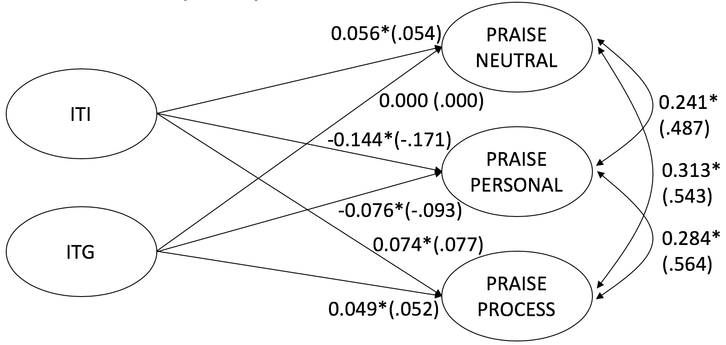
Results
Model fit Chi-Square = 44303.506; df = 396; P = < .001
RMSEA = 0.152; 90% C.I. = 0.150 – 0.154; Prob RMSEA (<= .05) = < .001
CFI = 0.684; TLI = 0.630
WRMR = 5.406
Results (standardised values presented on the diagram in parenthesis):
ITI is stat. sig (*) related to all three PRAISE factors: Positive on PRAISE NEUTRAL and PROCESS, negative on PERSONAL.
ITG is stat. sig. (*) positively related to PRAISE PROCESS and negatively related to PERSONAL.
Chinese rated PRAISE NEUTRAL and PROCESS higher than Finnish students (0.828, p<.001; 0.425, p<.001).
Finnish rated PRAISE PERSONAL higher than Chinese students (-0.373, p<.001).
Ratings on PRAISE NEUTRAL and PROCESS scales become lower as students get older (-0.063, p<.001; -0.047, p<.001).
Males rated PRAISE NEUTRAL and PERSONAL higher than females (0.087, p=0.043; 0.091, p=0.012).
Only one grade effect: higher math grades positively connected to PRAISE PROCESS (0.041, p=0.041).

Slide 92
Results
4-9 grade students from Finland and China (N=1862)
ITI (α=.863)
(1) You have a certain amount of intelligence, and you really can’t do much to change it.
(2) Your intelligence is something that you can’t change very much.
(3) To be honest, you can’t really change how intelligent you are.
(4) You can learn new things, but you can’t really change your basic intelligence.
Neutral (α=.783)
(1) It went well.
(2) Fine result!
(3) Great!
(4) Wow! That’s a really good score!
Person (α=.682)
(5) You are so smart in this subject!
(6) You are so gifted!
(7) You always do great in exams!
Process (α=.791)
(8) I can see that you have put a lot of effort in learning new issues.
(9) You practiced a lot and it can be seen in this result!
(10) You must have worked hard for this score!
(11) It was worthwhile to read for the exam!
PRAISE NEUTRAL
+
ITI
–
PRAISE PERSONAL
–
ITG
+
PRAISE PROCESS
+
ITG (α=.854)
(1) You have a certain amount of giftedness, and you really can’t do much to change it.
(2) Your giftedness is something that you can’t change very much.
(3) To be honest, you can’t really change how gifted you are.
(4) You can learn new things, but you can’t really change your basic giftedness.

Slide 93
Thank you!
Petri Nokelainen
petri.nokelainen@tuni.fi
Tampere University Finland http://pglresearch.fi http://www.tuni.fi

Slide 94
References
Abelson, R. P. (1995). Statistics as Principled Argument. Hillsdale, NJ: Lawrence Erlbaum Associates.
Bergman, M.M. (Ed.) (2008). Advances in Mixed Methods Research: Theories and Applications. Los Angeles: Sage Publications.
Booth, W. C., Colomb, G. G., Williams, J. M., Bizup, J., & Fitzgerald, W. T. (2016). The Craft of Research. Fourth edition. Chicago: The University of Chicago Press.

Slide 95
References
Creswell, J.W., & Plano Clark, V.L. (2011). Designing and Conducting Mixed Methods Research. Second edition. Thousand Oaks: Sage Publications.
Denzin, N. K. (1978). The research act: A theoretical introduction to sociological methods. Second edition. New York: McGraw-Hill.
Flyvbjerg, B. (2004). Five misunderstandings about case-study research. In C. Seale, J. F. Gubrium, G. Gobo, & D. Silverman (Eds.), Qualitative Research Practice (pp. 420-434). London: Sage.
Greene, J. C., Caracelli, V. J., & Graham, W. F. (1989). Toward a Conceptual Framework for Mixed-Method Evaluation Designs. Educational Evaluation and Policy Analysis, 11(3), 255-274.

Slide 96
References
Jackson, S. (2006). Research Methods and Statistics. A Critical Thinking Approach. Second edition. Belmont, CS: Thomson.
Kenny, D. A. (1987). Statistics for the social and behavioral sciences. Boston: Little, Brown.
MacNaghten, P., & Myers, G. (2004). Focus groups. In C. Seale, G. Gobo, J. F. Gubrium, & D. Silverman (Eds.), Qualitative Research Practice (pp. 65-79). London: Sage.
Paré, G., Trudel, M. C., Jaana, M., & Kitsiou, S. (2015). Synthesizing information systems knowledge: a typology of literature reviews. Information and Management, 52(2), 183-199.

Slide 97
References
Saunders, M., Lewis, P., & Thornhill, A. (2009). Research methods for business students. Fifth edition. Essex: Pearson Education Limited.
Tabachnick, B., & Fidell, L. (1996/2013). Using Multivariate Statistics. New York: HarperCollins Publishers.
de Vaus, D. A. (2004). Research Design in Social Research. Third edition. London: Sage.

